Slide 1


Data Analysis Techniques 890F3
Terminology & Concepts

Slide 2
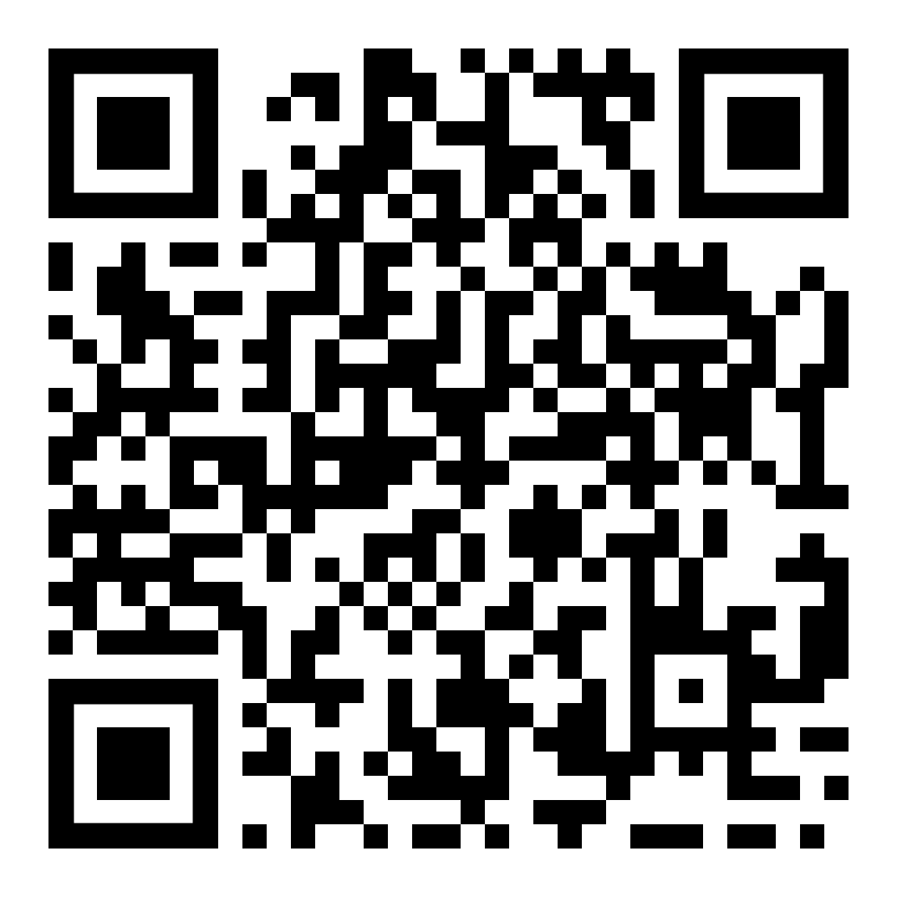
Reminder from Intro Lecture: About the Module
https://dorksquith.github.io/DataAnalysisTechniques/

Slide 3
Reminder
This week is chaotic for some of you and for all of me 😅
Week 1 tasks for you:
Take the time to decide if this is the right module for you by reviewing the jupyter book notes available
Work through Terminology & Concepts
Do a first read of Probability Essentials before we meet on Monday
Things will be more settled from next week. Fixed lecture theatres, canvas access, slides available before lecture and all that sort of thing.

Slide 4
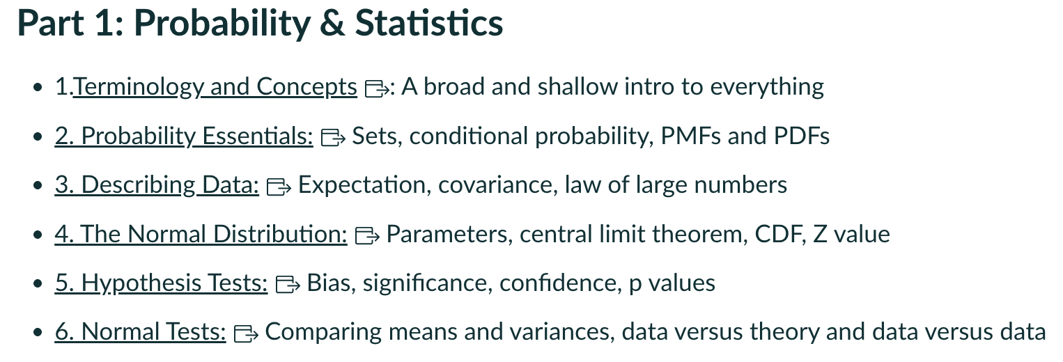
Where we are

Slide 5
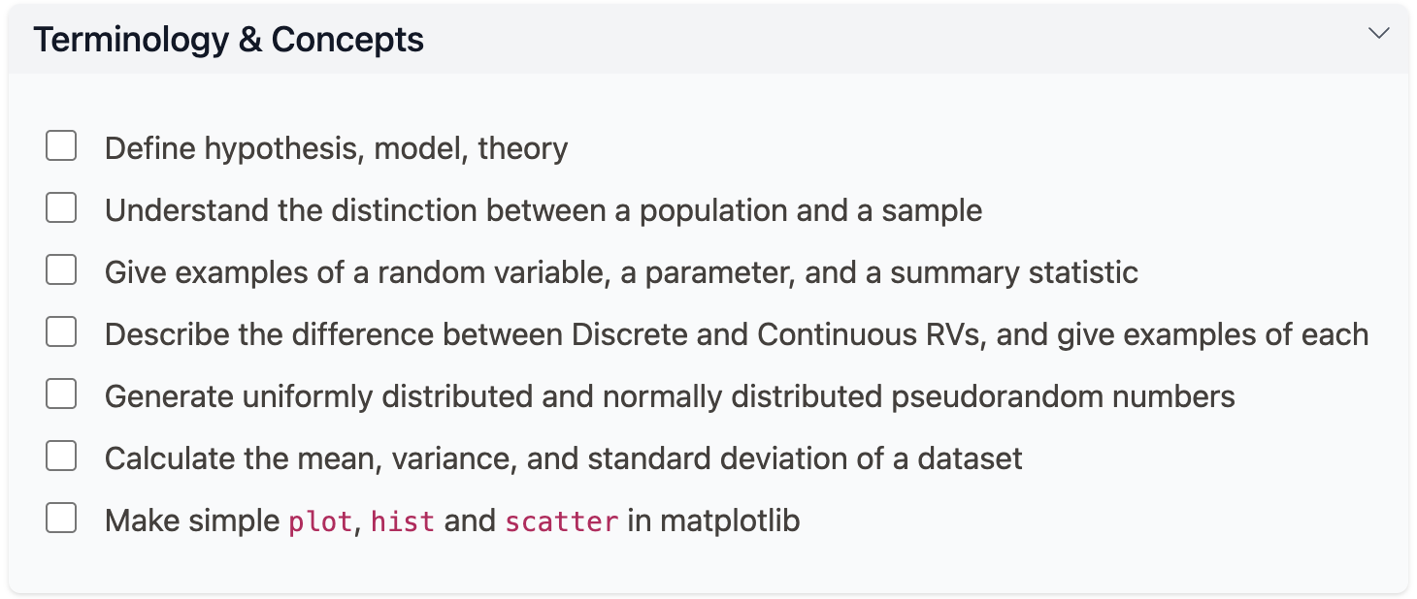
Learning Objectives

Slide 6
Hypothesis, Model, Theory
Example: My mother’s roof appears to be leaking
Hypothesis: mice have chewed through the roofing felt
Model: a small amount of water runs through the (chipped) clay roof tiles and finds its way into the wall cavity.
W = f(x; θ) … the model must be specific eg Ax + Bx²
The volume of water on the inside wall W is a function of some measurable x, eg where we are looking on the wall, and some parameters θ={A,B, ..}, eg the time since the last major rain storm, the state of the tiles, and the condition of the roof felt.
Theory: physics of fluids, materials, and gravity

Slide 7
Population & Sample
Population: the maximum number of data points we can possibly gather*.
Sample: a subset of the population.
The distinction is important because the reliability of all the statistics we calculate depend on N: the sample size.
I won’t linger much on Populations here, but will instead go straight to The Truth.

Slide 8
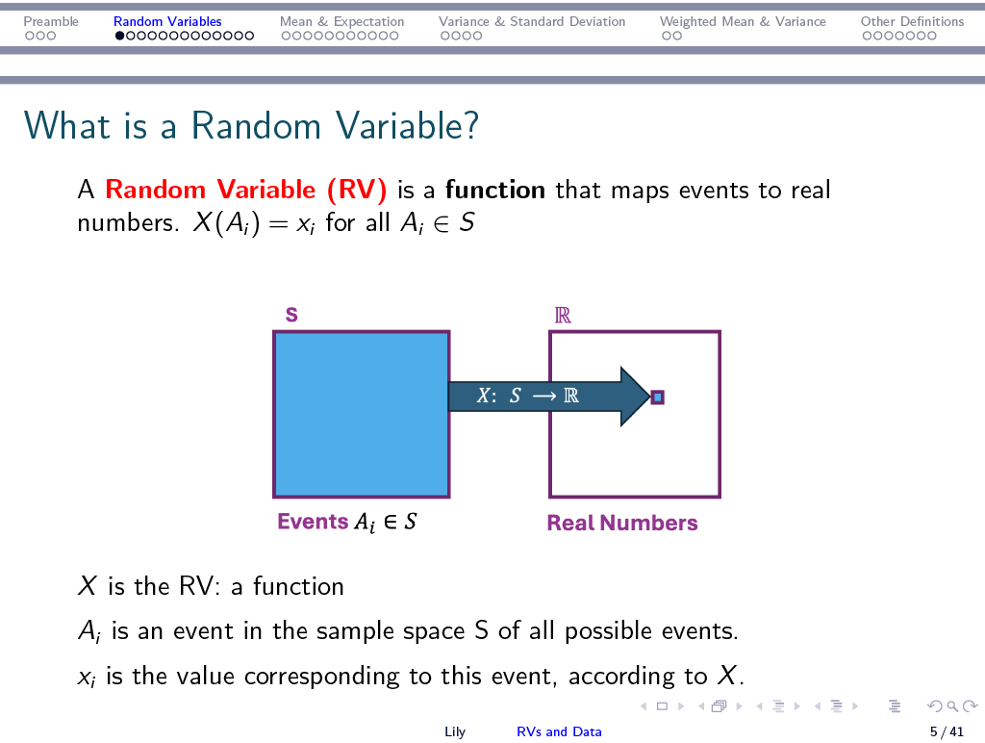

Slide 9
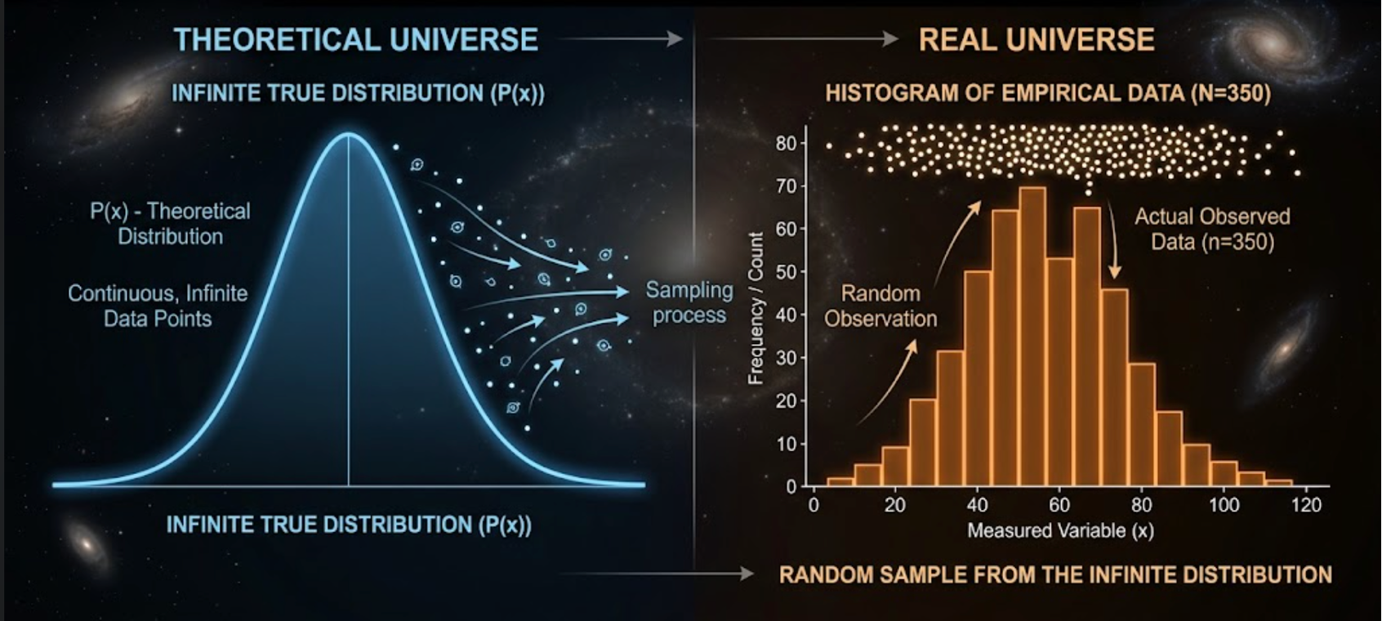

Slide 10
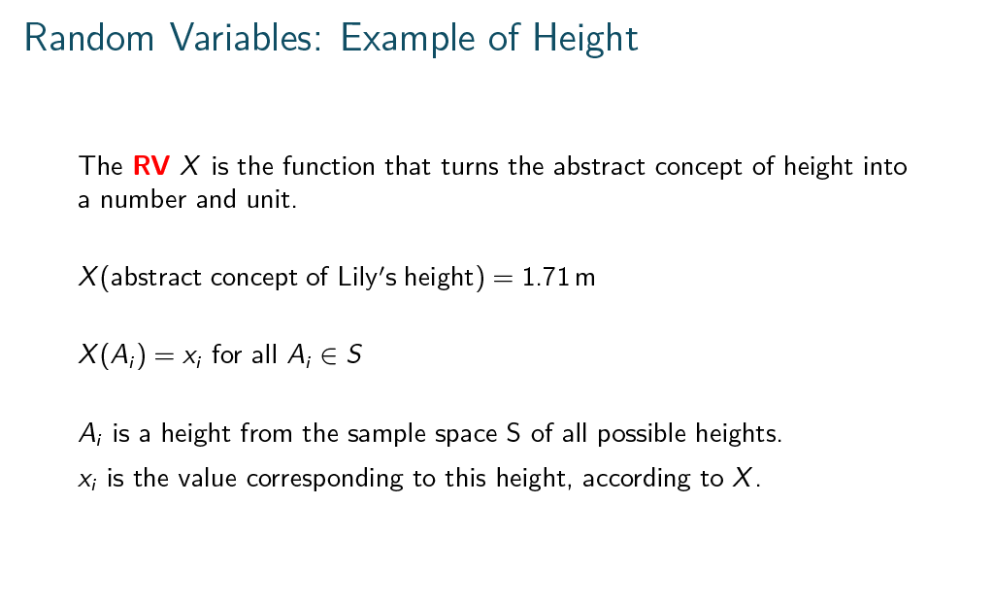

Slide 11
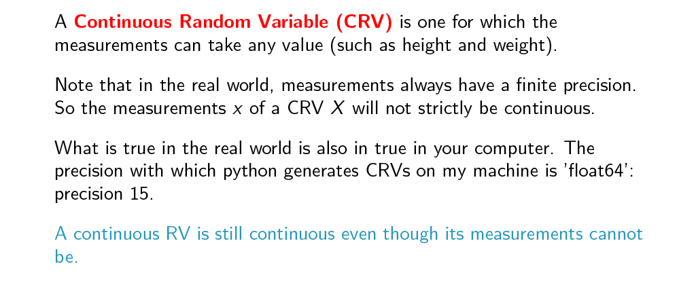

Slide 12
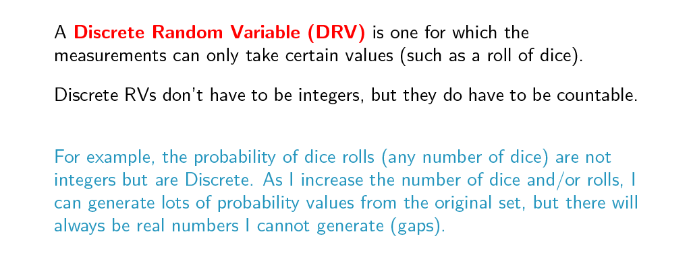

Slide 13
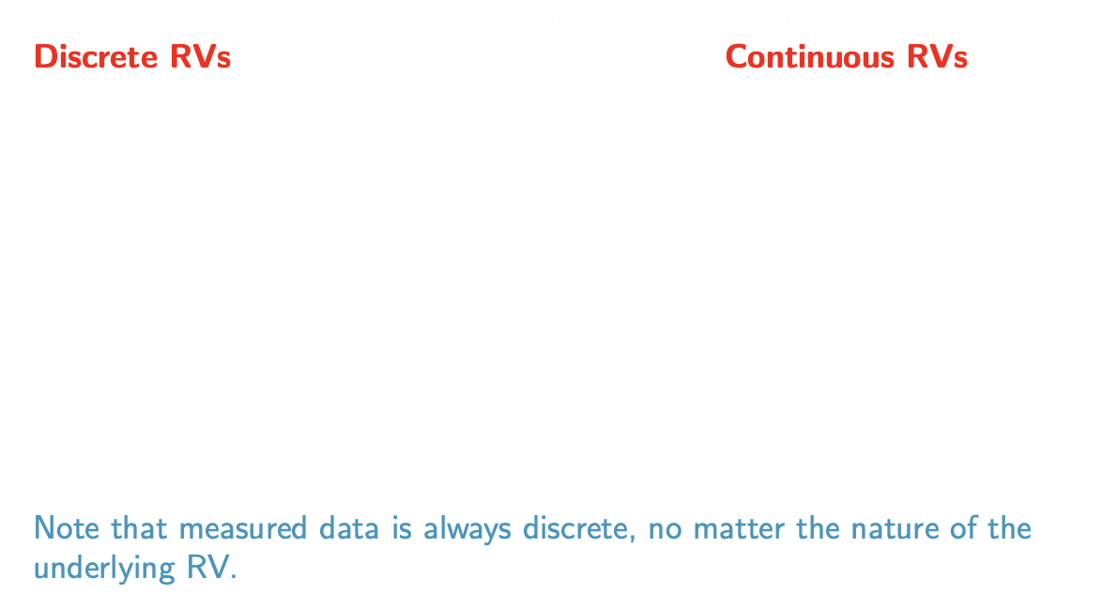

Slide 14
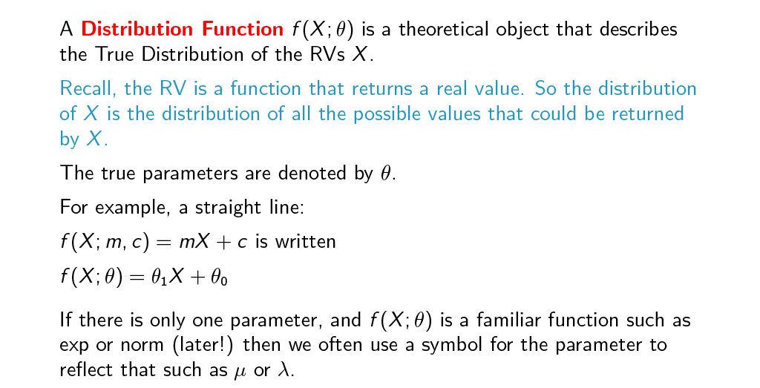

Slide 15
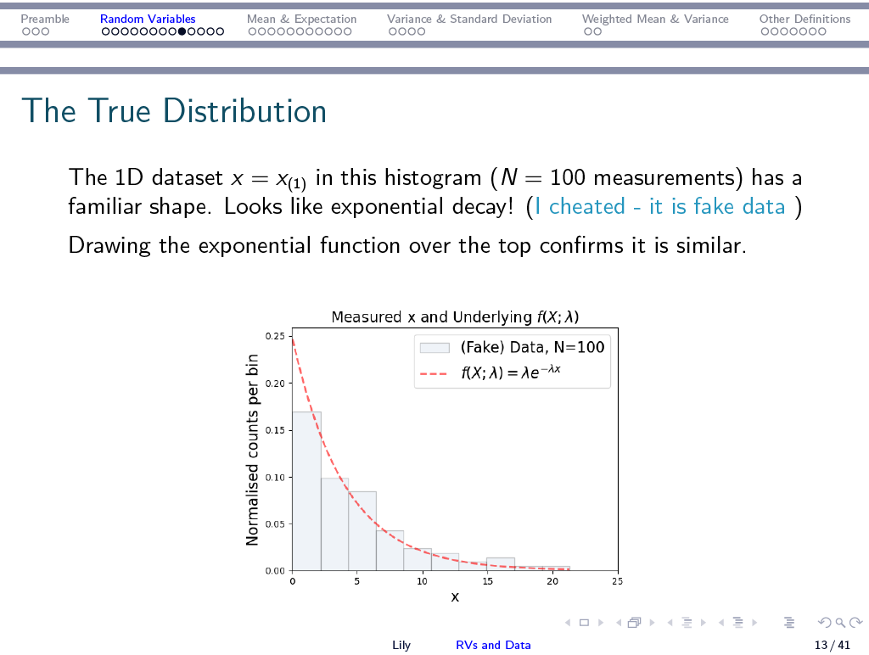
Model
Parameter of the model: λ
Different parameter choice => different shape

Slide 16
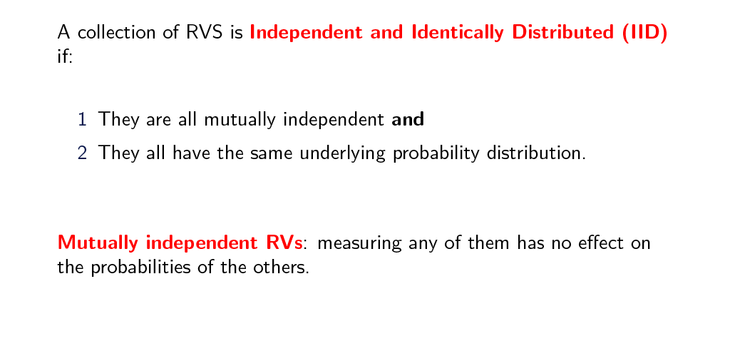

Slide 17
A side-step into probability
Let’s go to the park. I am in the park with my friend Alf, leaning against a tree, tossing a coin. Alf notices that I get three heads in a row.
Alf hasn’t really got any eyebrows, but I can tell he is interested in this run of three heads by his demeanour.
I offer him a wager on the next toss. What does he bet?

Slide 18
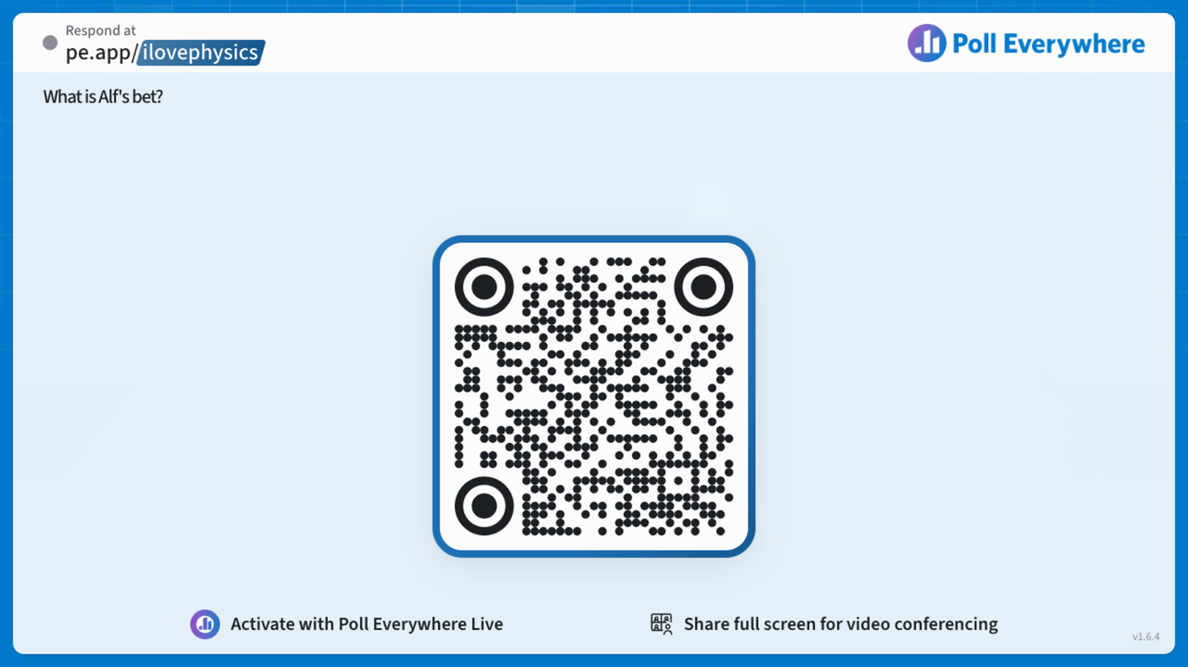

Slide 19
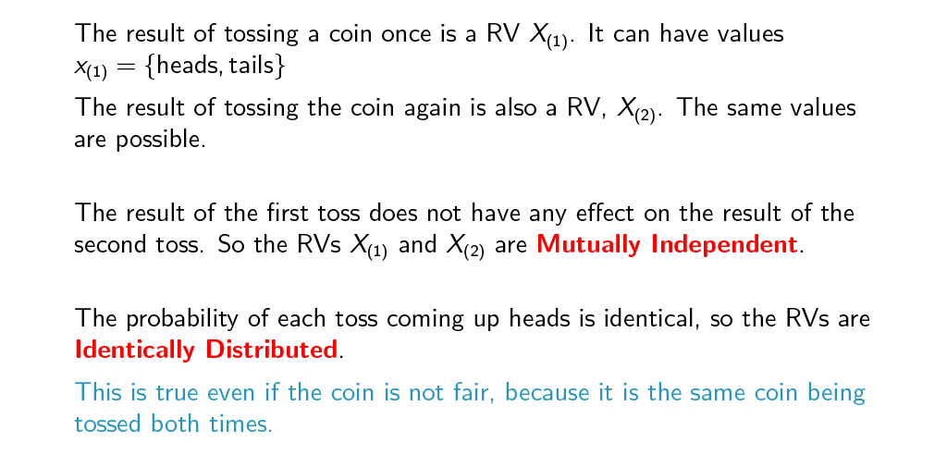

Slide 20
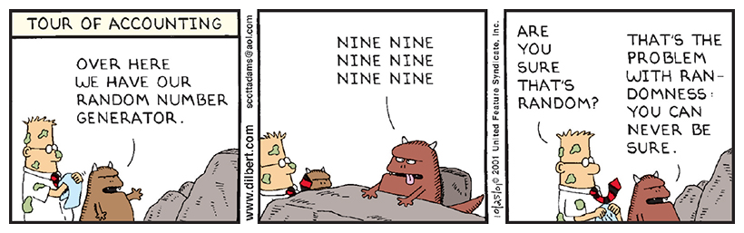
Random?
Credit: DILBERT © 2001 Scott Adams [All rights reserved].

Slide 21
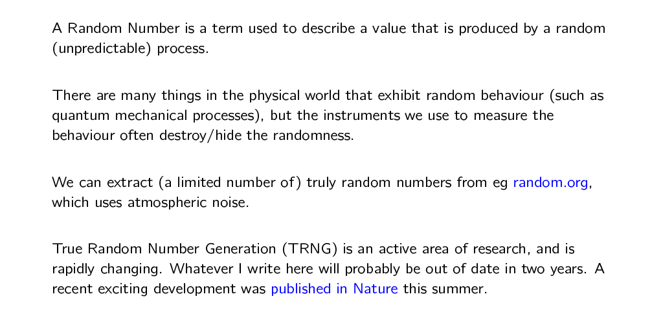
True Random Numbers (for cryptography)

Slide 22
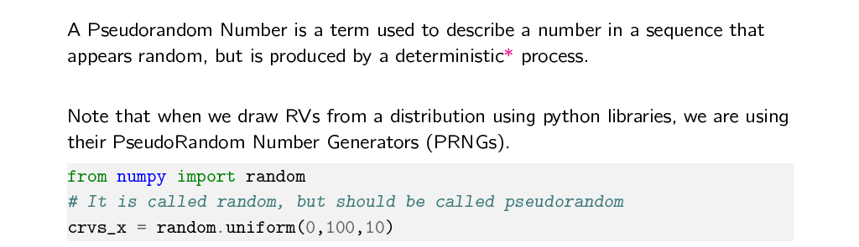
PseudoRandom Numbers (for us)

Slide 23
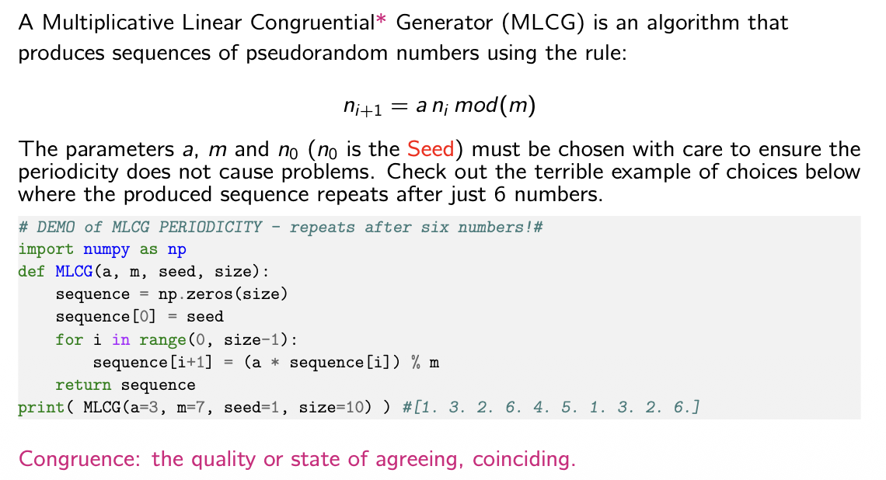
An (outdated) PRN (don’t worry, numpy doesn’t use this)

Slide 24
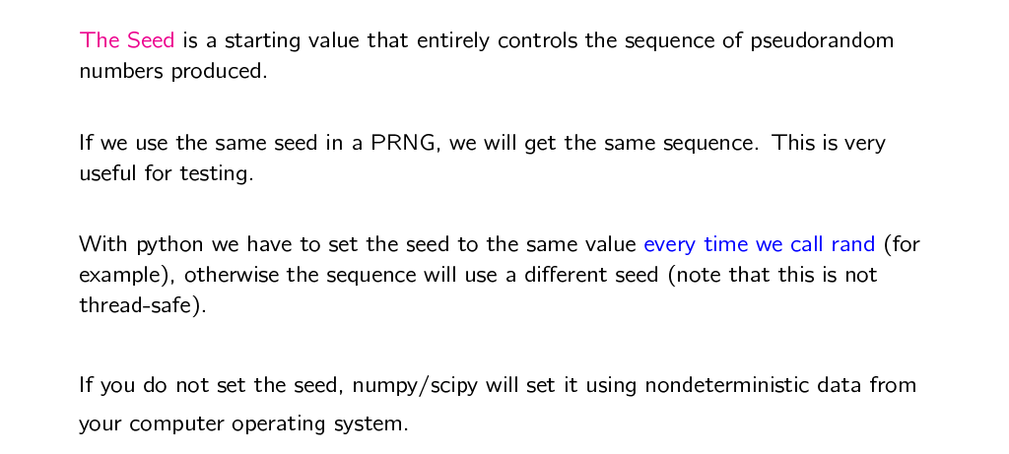
The Seed
Only use a seed for testing!

Slide 25
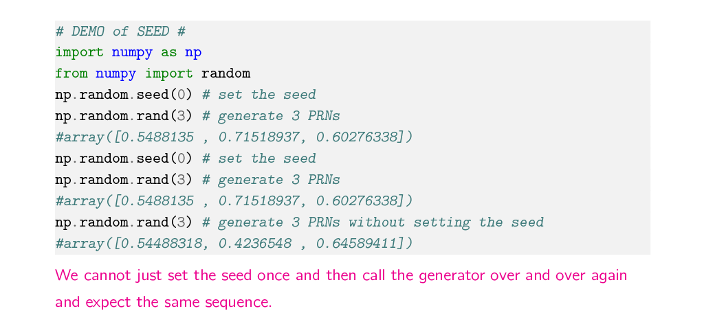
Setting the Seed
Only use a seed for testing!

Slide 26
One more time…
Take the time to decide if this is the right module for you by reviewing the jupyter book notes available
Read through Terminology & Concepts
Do a first read of Probability Essentials before we meet on Monday
Come to the workshop on Wednesday for tech support & chats

Slide 27
